Slide 1
What Is Software Engineering?
CTEC1332 Software Engineering Practices
Version 1.2; Last Modified: 2021-08-17

Slide 2
Software Engineering

Slide 3
Problem Solving
You must be able to solve problems in order to succeed in academics or in the real world.
Problem-solving ability is a combination of art and science.
In the real world, the process is more difficult because problem descriptions are often incomplete, imprecise, or ambiguous.
Software Engineering

Slide 4
The Engineering and Scientific Method
Recognize and understand the problem.
Accumulate facts.
Select the appropriate theory or principle.
Make necessary assumptions.
Solve the problem.
Verify and check results.
Software Engineering

Slide 5
What is "Engineering"?
A discipline based on science to solve practical problems in the service of humanity.
Repeatable and based on professionalism
Understanding technologies; making decisions based on balancing trade-offs
Software Engineering

Slide 6
What is "Software Engineering"?
From Frederick P. Brooks’ The Mythical Man-Month: Essays on Software Engineering...
how to design and build a set of programs into a system
how to design and build a program or a system into a robust, tested, documented, supported product
how to maintain intellectual control over complexity in large doses
Software Engineering

Slide 7
What is "Software Engineering"?
means developing software that has certain qualities
meets its stated requirements
is useful and useable
can be created with predictable schedule, budget, performance, reliability and robustness
Software Engineering

Slide 8
What is "Software Engineering"?
It's not just programming!
includes requirements gathering, design, modeling, programming, quality assurance (QA), deployment, and maintenance
also has non-engineering concerns
economic concerns These are not engineering concerns, but legitimate concerns none the less
Software Engineering

Slide 9
Software Engineering
Systems designers in the computer industry have found that the engineering and scientific method of problem solving can be adapted to the development of reliable software systems as well.
This approach is called software engineering.
Software Engineering

Slide 10
Software Engineering
“Real software engineers don't debug programs, they verify correctness. This process doesn't necessarily involve execution of anything on a computer, except perhaps a Correctness Verification Aid package.”
(found on Slashdot)
Software Engineering

Slide 11
Software Engineering Methodology
Requirements Specification.
Analysis.
Design.
Implementation.
Verification and Testing.
Software Engineering

Slide 12
Software Engineering -- Definition
“… Engineering principles
applied to development of reliable,
efficient,
maintainable
software…”

Slide 13
Software Engineering – A Brief History
“Early Years” – S/W as an afterthought; custom S/W
“2nd Era” – product S/W
“3rd Era” – low cost H/W; distributed software
“4th Era” – AI, machine learning, blockchain, … “you are here”

Slide 14
Software -- Definition
Instructions that when executed provide desired function and performance, and
Data structures that enable the program to adequately manipulate information, and
Documents that describe the operation and use of the programs.

Slide 15
“Amusing” Software Properties
Logical, not physical
Not “manufacturable” --- engineered; a purely logical component
Doesn’t wear out like H/W
But – maintenance; each “bug” fixed may introduce new bugs

Slide 16
“Amusing” Software Properties
may increase!
bugs “fixed”

Slide 17
“Amusing” Software Properties – The Moral(s) of the Story
Software must be well designed and documented for maintainability.
More money is (often) spent on software maintenance than on software definition and development.
There is always “one more bug” (Murphy’s Law)

Slide 18
Types of Software Applications
System Software: compilers, operating systems
Real Time Software: response times guaranteed to be within a specific range, e.g., nuclear power plant control
Business: for maximum profit!
Engineering/Scientific: number crunching; CAD/CAM; visualization; simulation
Embedded: microcontroller-based; IoT; e.g., microwave oven control
PC, mobile, etc. (stupid category)
Artificial Intelligence (AI) & Machine Learning (ML)

Slide 19
Major Software Management Problems
Cost/time estimation
Productivity (of programmers)
Quality
“Customer Satisfaction”
Maintenance

Slide 20
Software “Life Cycle” – Classic Model
”waterfall”
System
Engineering
Analysis
Design
Coding
Testing
Maintenance

Slide 21
Software “Life Cycle” – Classic Model
System Engineering: partition the problem (and specify context) -- “what goes in the software?”
Analysis: define what the software must do
Design: define how it must do it
Data structures
Overall architecture
Procedure details
Coding
Testing
Maintenance

Slide 22
The Original Waterfall Model (1970)
Source: Royce, Winston W. “Managing the Development of Large Software Systems”, Proceedings, IEEE WESCON, August 1970.
Software Eng

Slide 23
The Waterfall Model (2)
Typical progression from one stage to the next
Feedback at any stage can force the process to go backwards, ultimately to improve the software
Source: https://airbrake.io/blog/sdlc/waterfall-model Retrieved on May 12, 2018
Software Eng

Slide 24
The Waterfall Model (3)
A more “agile” approach,
with more frequent
feedback, including from the user,
during the development stages
This path represents
“the software has what I need,
but it’s not what I want”
Source: https://www.arum.co.uk/how-can-an-agile-approach-be-used-for-collections-system-development/ Retrieved on May 12, 2018
Software Eng

Slide 25
Prototyping* (Exploratory Programming)
Requirements gathering
Quick
design
Prototype
Evaluate & refine
Produce
product
*also, Rapid Application Development (RAD)

Slide 26
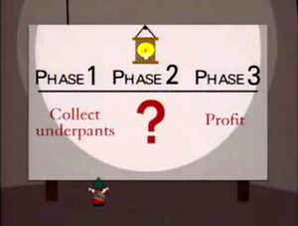
Software “Life Cycle” – Next Generation
Coding is “automatic” -- goes from very-high-level description to code via a compiler
https://en.wikipedia.org/wiki/Gnomes_(South_Park)

Slide 27
Software Development Life Cycle (SDLC)
In software engineering, a software development process is the process of dividing software development work into distinct phases to improve design, product management, and project management.
The methodology may include the pre-definition of specific deliverables and artifacts that are created and completed by a project team to develop or maintain an application.
https://en.wikipedia.org/wiki/Software_development_process

Slide 28
Systems Development Life Cycle (SDLC)
The systems development life cycle (SDLC), also referred to as the application development life-cycle, is a term used in systems engineering, information systems and software engineering to describe a process for planning, creating, testing, and deploying an information system.
Example: web site development
https://en.wikipedia.org/wiki/Systems_development_life_cycle

Slide 29
Agile
Active user involvement is imperative.
The team must be empowered to make decisions
Requirements evolve but the timescale is fixed.
Capture requirements at a high level; lightweight & visual
Develop small, incremental releases and iterate
https://project-management.com/10-key-principles-of-agile -software-development/

Slide 30
Agile
Focus on frequent delivery of products
Complete each feature before moving on to the next
Apply the 80/20 rule
Testing is integrated throughout the project lifecycle – test early and often
A collaborative & cooperative approach between all stakeholders is essential
https://project-management.com/10-key-principles-of-agile -software-development/

Slide 31
Agile
http://dilbert.com/strip/2005-11-16

Slide 32
Methods Specifically Designed Around Agile Development
DSDM (Dynamic systems development method) is probably the original Agile Development method. DSDM was around before the term Agile Development was even invented, but is absolutely based on all the principles we’ve come to know as Agile Development.
SCRUM is also an Agile Development method, which concentrates particularly on how to manage tasks within a team-based development environment.
https://project-management.com/10-key-principles-of-agile -software-development/

Slide 33
Methods Specifically Designed Around Agile Development (2)
XP (eXtreme Programming) is a more radical Agile methodology, focusing on the software development process and addressing the analysis, development and test phases with novel approaches aimed at making a substantial difference to the quality of the end product.
DSDM is probably the most complete Agile methodology, whereas SCRUM and XP are easier to implement and complementary because they tackle different aspects of development projects and are both founded on the same principles of Agile Development.
https://project-management.com/10-key-principles-of-agile -software-development/

Slide 34
Scrum
Scrum is a method of agile development that can help any development team to ship a final product in a small period of time.
It is widely used in startups and software companies around the world.
https://miguelgfierro.com/blog/2014/what-is-scrum-and-how-to-apply-it-to-a-startup/

Slide 35
Scrum
The main goal of scrum is to deliver a potentially shippable product increment in a fixed period.
The process begins with a Product Backlog. The product backlog is a TODO list of all the tasks that has to be completed.
Some of these tasks are included in the Sprint, which consist on a period between 2 and 4 weeks in which a new feature in the product is completed.
Also, every day the team have a Daily Scrum Meeting, to see how the process is going.
https://miguelgfierro.com/blog/2014/what-is-scrum-and-how-to-apply-it-to-a-startup/

Slide 36
DSDM Atern
Atern is a vendor-independent approach that recognises that more projects fail because of people problems than technology.
Atern’s focus is on helping people to work effectively together to achieve the business goals.
https://en.wikipedia.org/wiki/Dynamic_systems_development_method

Slide 37
DSDM Atern
Focus on the business need
Deliver on time
Collaborate
Never compromise quality
Build incrementally from firm foundations
Develop iteratively
Communicate continuously and clearly
Demonstrate control
https://en.wikipedia.org/wiki/Dynamic_systems_development_method

Slide 38
Defects
The cost of detecting and fixing defects in software increases exponentially with time in the software development workflow.
Fixing bugs in the field is incredibly costly and risky — often by an order of magnitude or two.
The cost is not just in the form of time and resources wasted in the present, but also in form of lost opportunities in the future.
https://dzone.com/articles/the-exponential-cost-of-fixing-bugs

Slide 39
Defects
Most defects end up costing more than it would have cost to prevent them. Defects are expensive when they occur, both the direct costs of fixing the defects and the indirect costs because of damaged relationships, lost business, and lost development time. — Kent Beck, Extreme Programming Explained
https://dzone.com/articles/the-exponential-cost-of-fixing-bugs

Slide 40
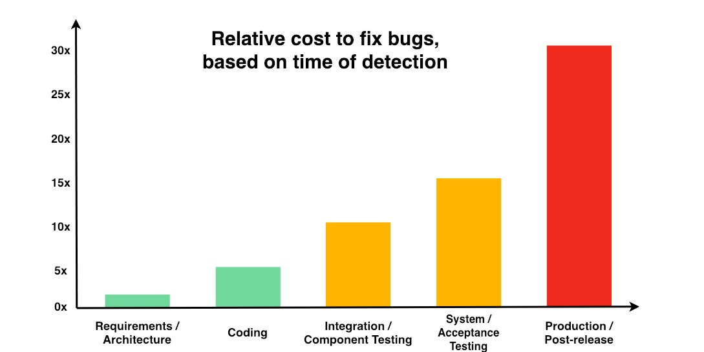
https://dzone.com/articles/the-exponential-cost-of-fixing-bugs

Slide 41
DevOps
DevOps is a set of practices that combines software development (Dev) and IT operations (Ops).
It aims to shorten the systems development life cycle and provide continuous delivery with high software quality.
https://en.wikipedia.org/wiki/DevOps

Slide 42
References
McCrackin, D. C. “CE3VA3 Software Engineering Class Notes”, McMaster University, 1991.
Other sources as noted on specific slides.

